Slide 1
Aid Escalating Coverage: - Evaluation 2
Date: - 20th November 2022

Slide 2
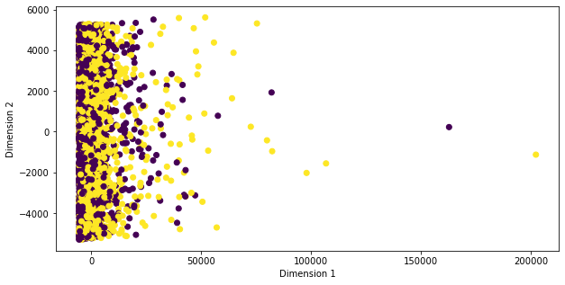
1.) More Robust Feature Selection : -
I will be following the post : - https://towardsdatascience.com/feature-selection-techniques-for-classification-and-python-tips-for-their-application-10c0ddd7918b
Unsupervised Technique (PCA)
We can see, PCA is unable to segregate the class labels into a more linearly separable space, therefore, more techniques are carried out.

Slide 3
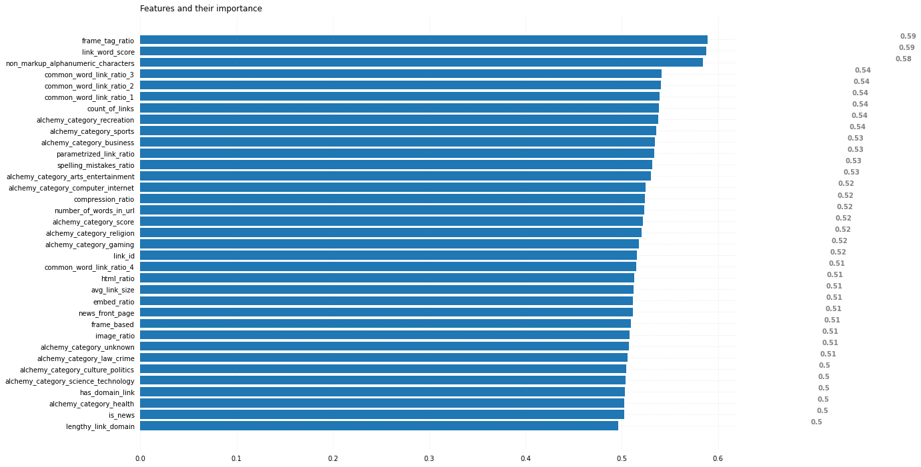
2.) Univariate Filtering techniques
I have fit a LR, to each feature to see their importance. This technique is used to find features, if any, that stand out and have high independent correlation with the label.

Slide 4
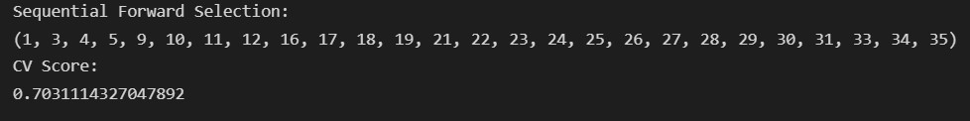
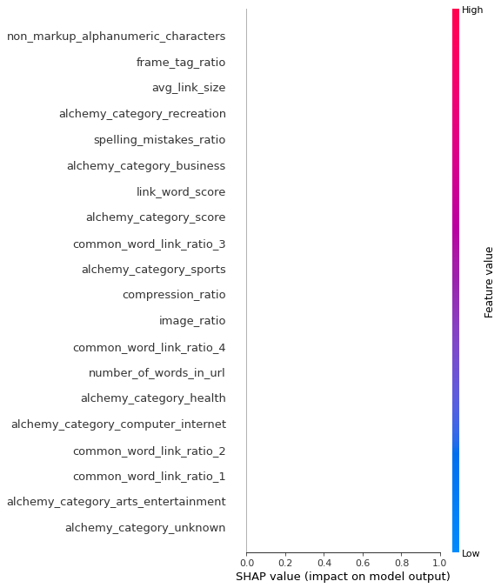
3.) Wrapper Technique (Most accurate, Computationally expensive)
In this technique, I have used the 3rd party library mlxtend to perform exhaustive and sequential forward and backward searching of the optimal parameters with the optimal model.
The output corresponds to the index numbers of the features with a LR solver.
4.) Tree based models (Using XGBoost, to overcome the computational problems of 3)

Slide 5
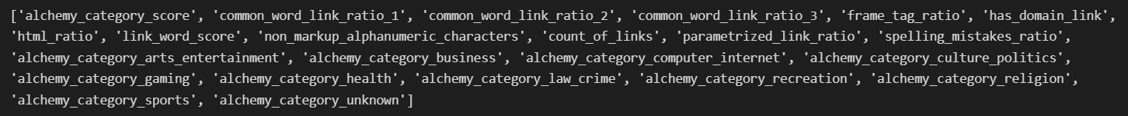
2.) Finalised Features : -
The above are the non-textual features to be used, as obtained by SFS from step 3.
The textual features, “page_description” is preprocessed by extracting their components, and then removing all extra spaces, converting everything to lowercase, removing stop words, single letter words, removing numbers and finally lemmatization. Using urlparse, the same procedure is done for “link” feature.
TF-IDF is used, as discussed last time, over bag of words.
Now, we introduce columns in the training and testing data frames that have completely preprocessed textual data. “text_title” holds the title component of page_description, “text_url” holds the url component of page_description, “text_body” holds the body, “parsed_link” contains the preprocessed link data, “Complete_Textual_Data” contains the concatenation of the previously mentioned 4 columns and “parsed_page_description” contains the concatenation of the parsed page_description strings.

Slide 6
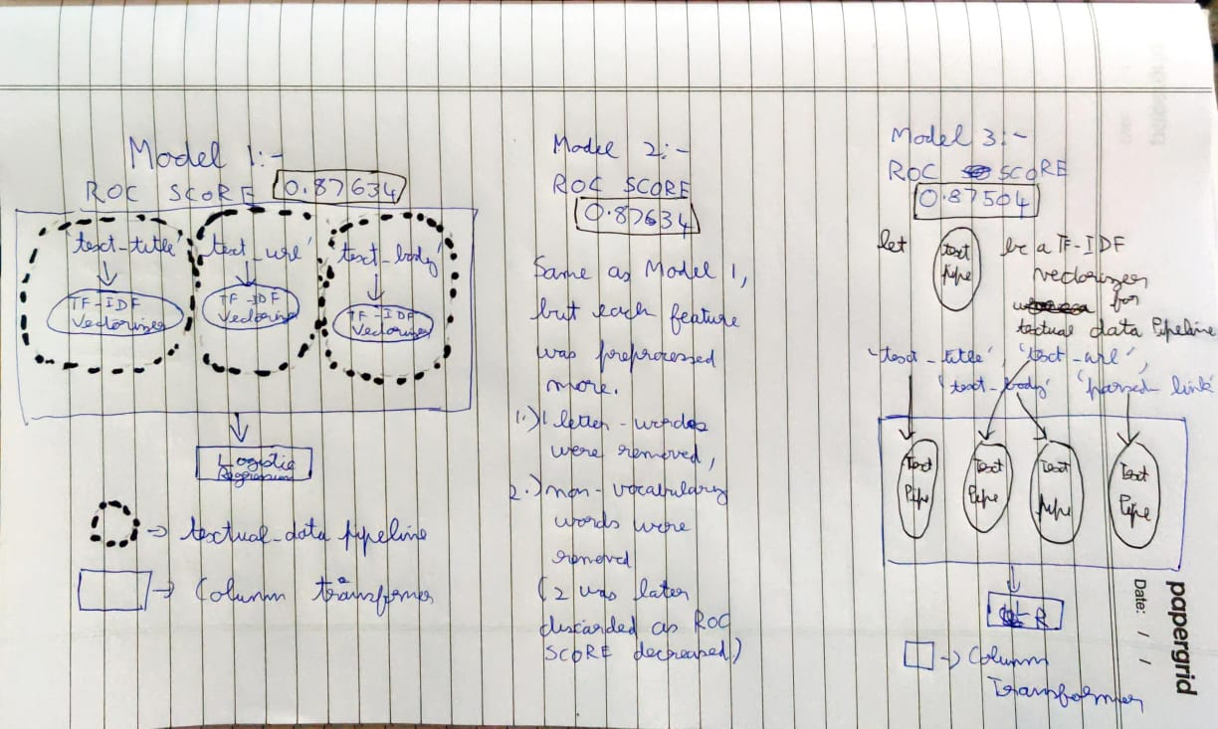
3.) Model Ensemble : -

Slide 7
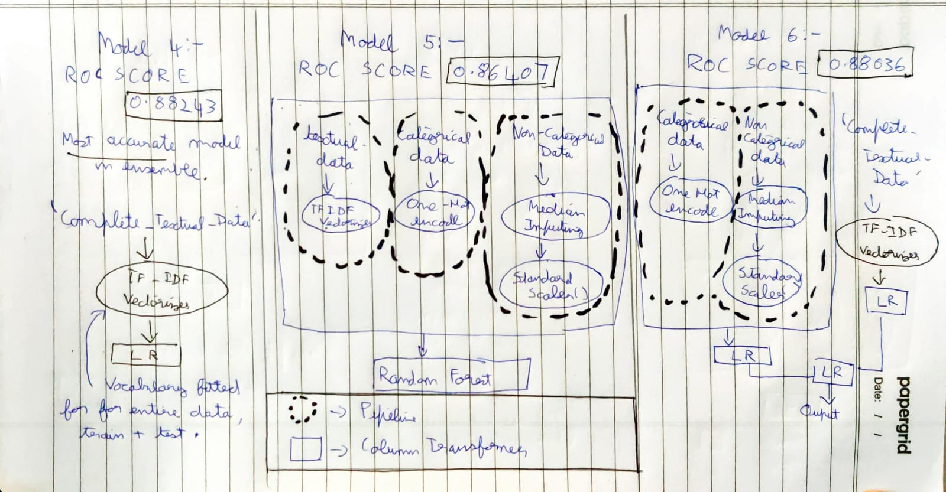

Slide 8
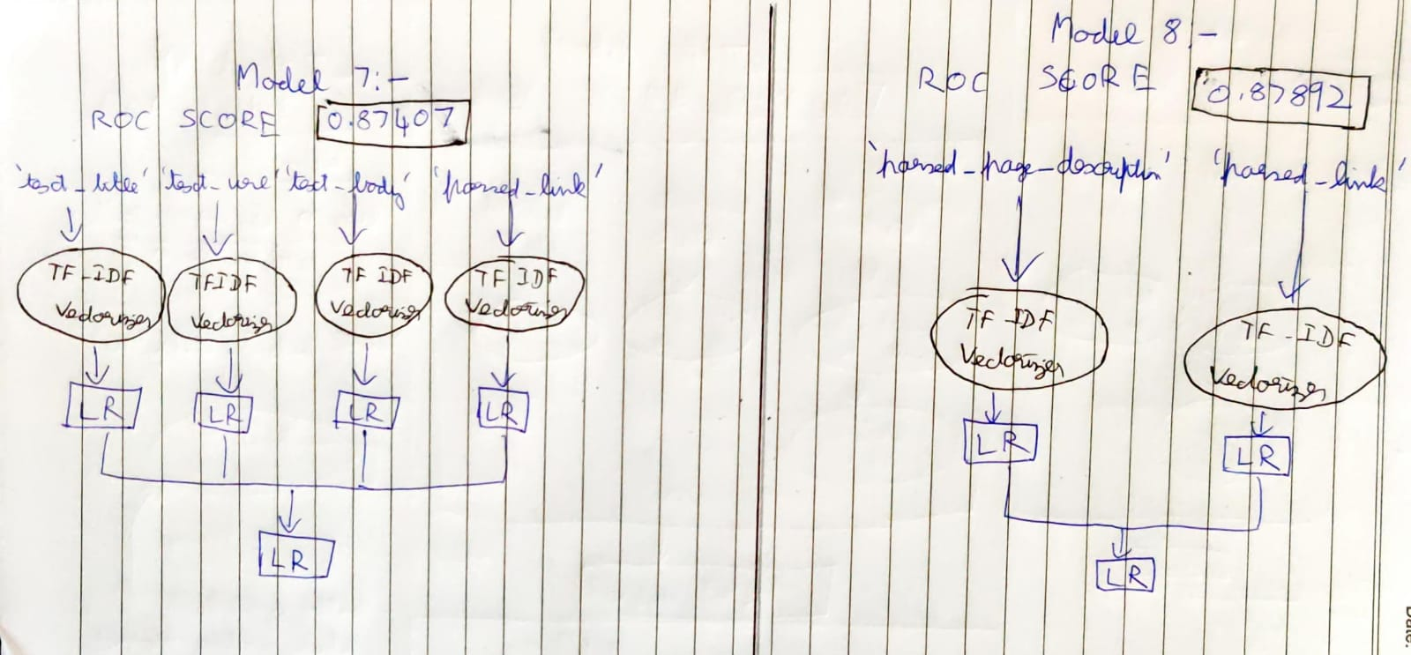

Slide 9
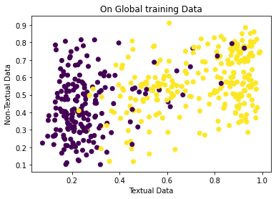
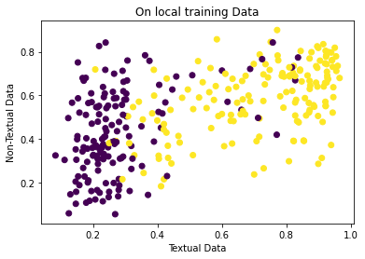
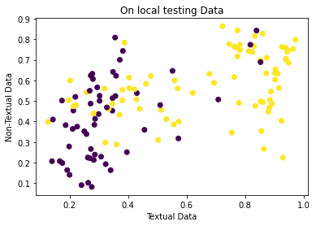
4.) Conclusion
From these visualisations generated from the output of model 6, we can see the model intrinsically trains the data from the textual features with far more weightage than the non-textual features.
Fitting a TF-IDF vectorizer’s vocabulary of a feature gives more accuracy when vocabulary is fitted with train + test data. Also higher and highest roc scores were received by models which used only textual data.
For the next eval, we would use deep learning architectures, by using transfer learning and finetune some layers with our dataset. This highly suits our relatively sparse and small dataset.

Slide 10

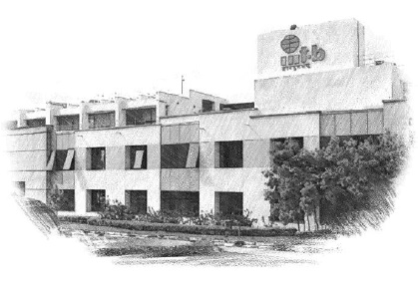






International Institute of Information Technology Bangalore
26/C, Electronics City, Hosur Road,
Bengaluru – 560 100, Karnataka, India
www.iiitb.ac.in
https://www.facebook.com/IIITBofficial/
https://twitter.com/IIITB_official
https://www.linkedin.com/school/iiit-bangalore/
https://www.youtube.com/user/iiitbmedia
https://www.instagram.com/iiitb_official/

